Slide 1
Website for selling laptops
Student: Lê Hoàng Minh Quân B2206008

Slide 2
Function List
Log In
Log Out
Seach by Name
Cart product management (add, update, remove)
Checkout

Slide 3
Technology List
HTML
CSS
Javascript
PHP
MySQL
Session
Pagination
Cookie
Async Await
Fetch

Slide 4
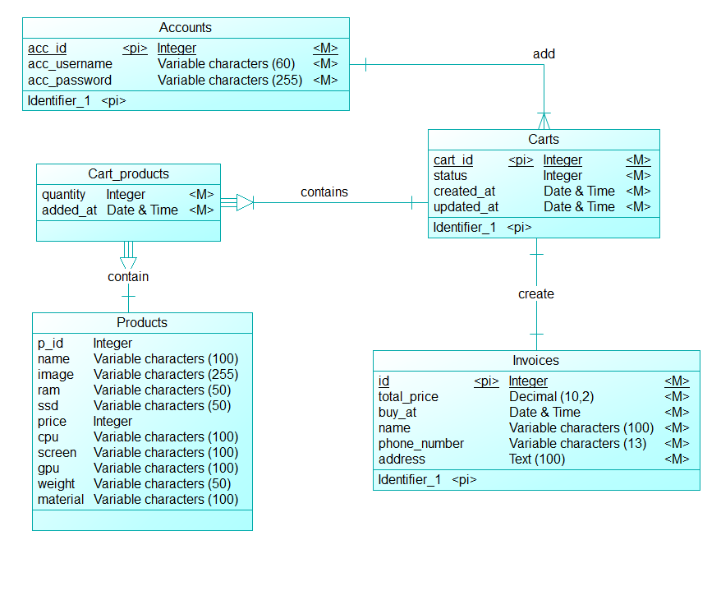
Database schema

Slide 5
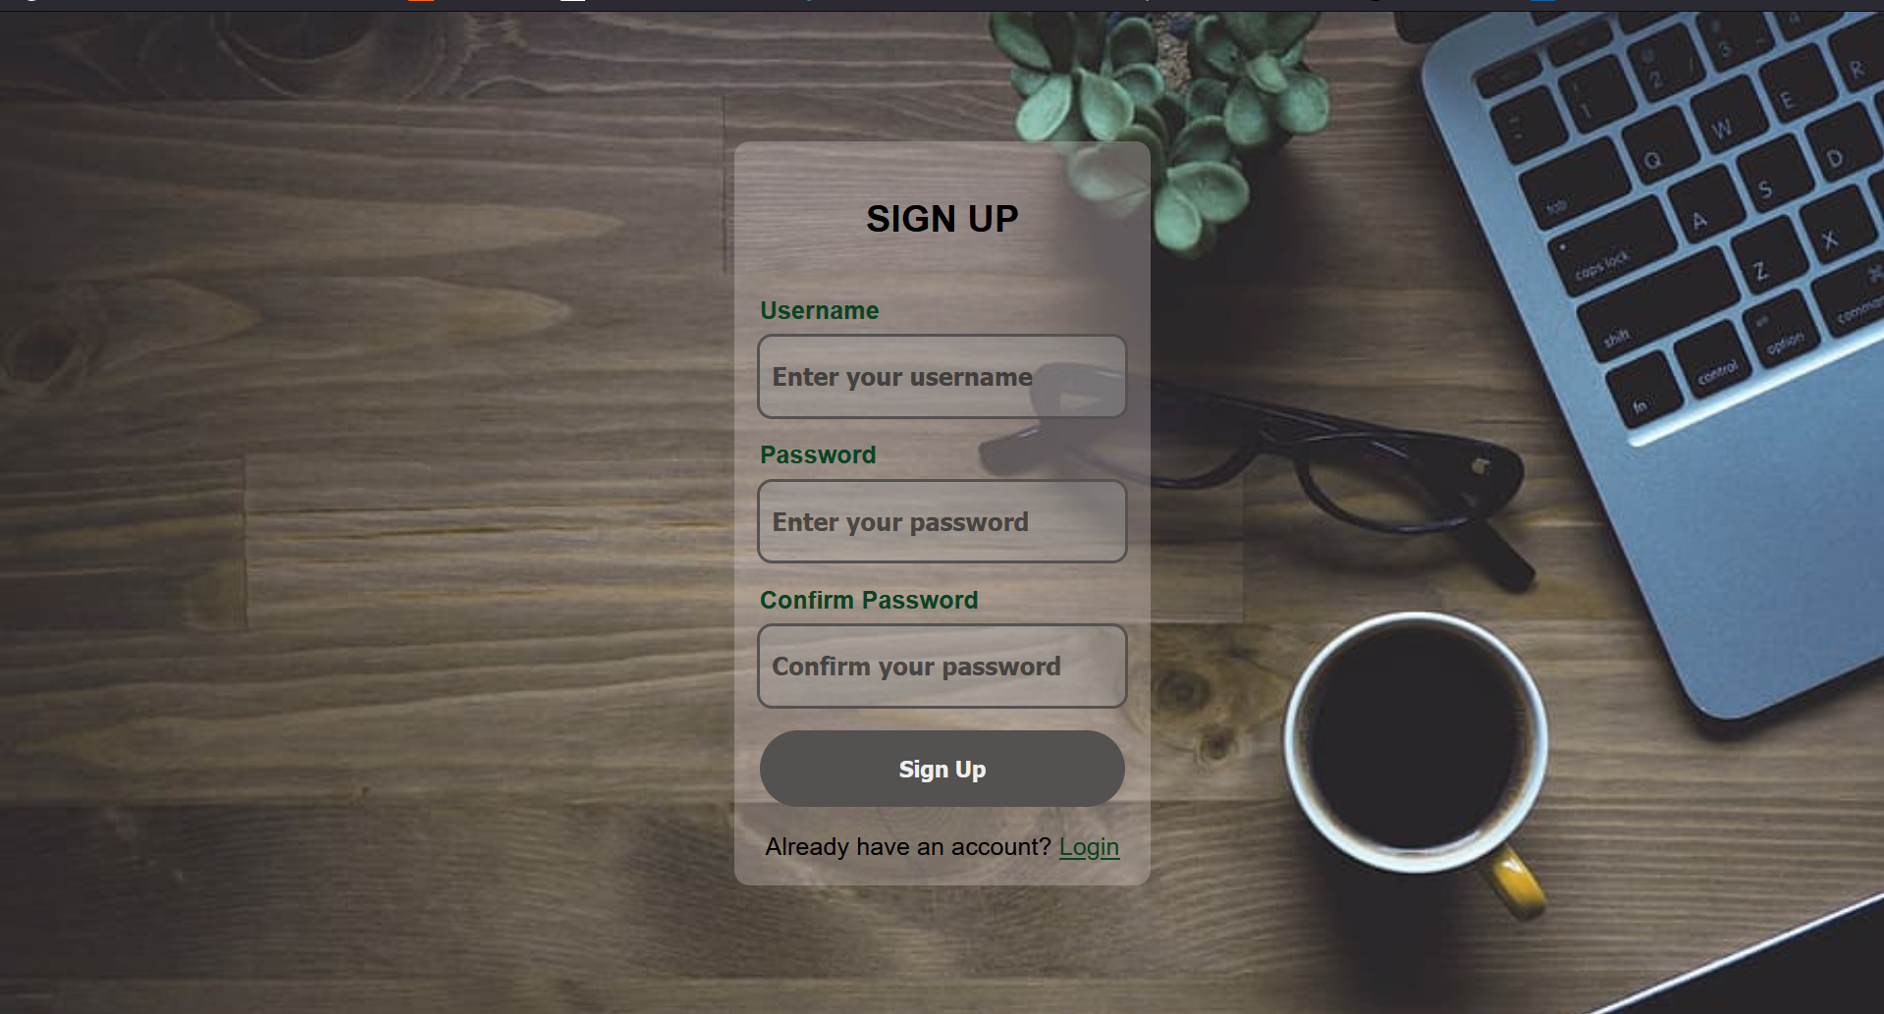
Sign up page

Slide 6
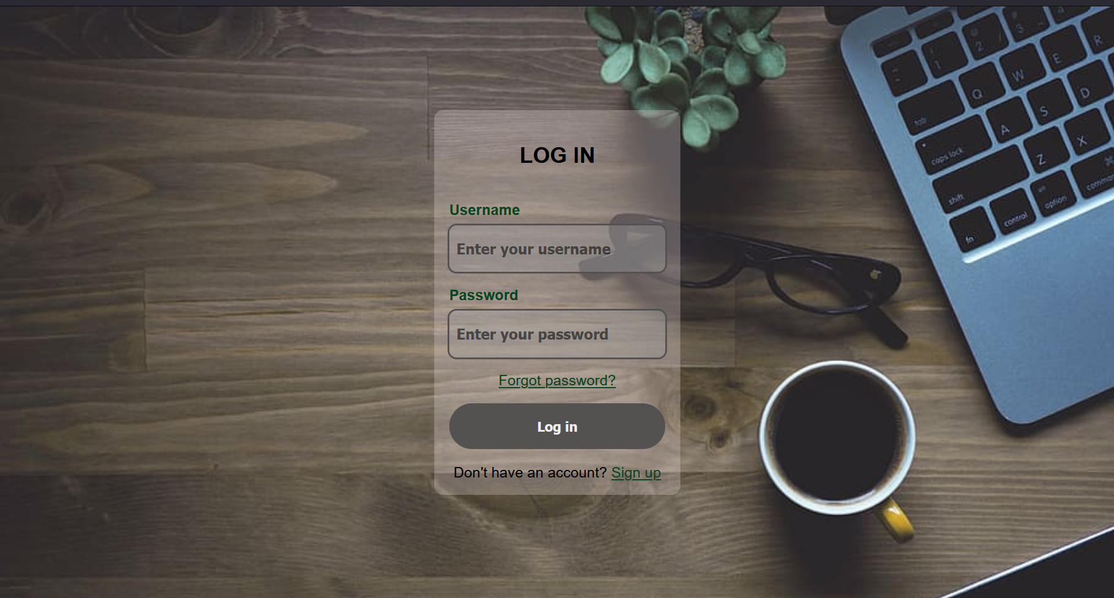
Log In page

Slide 7
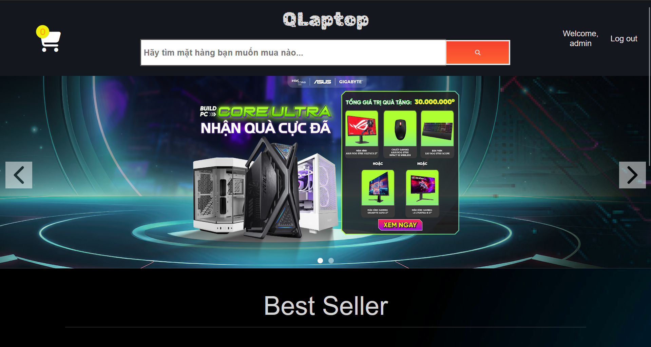
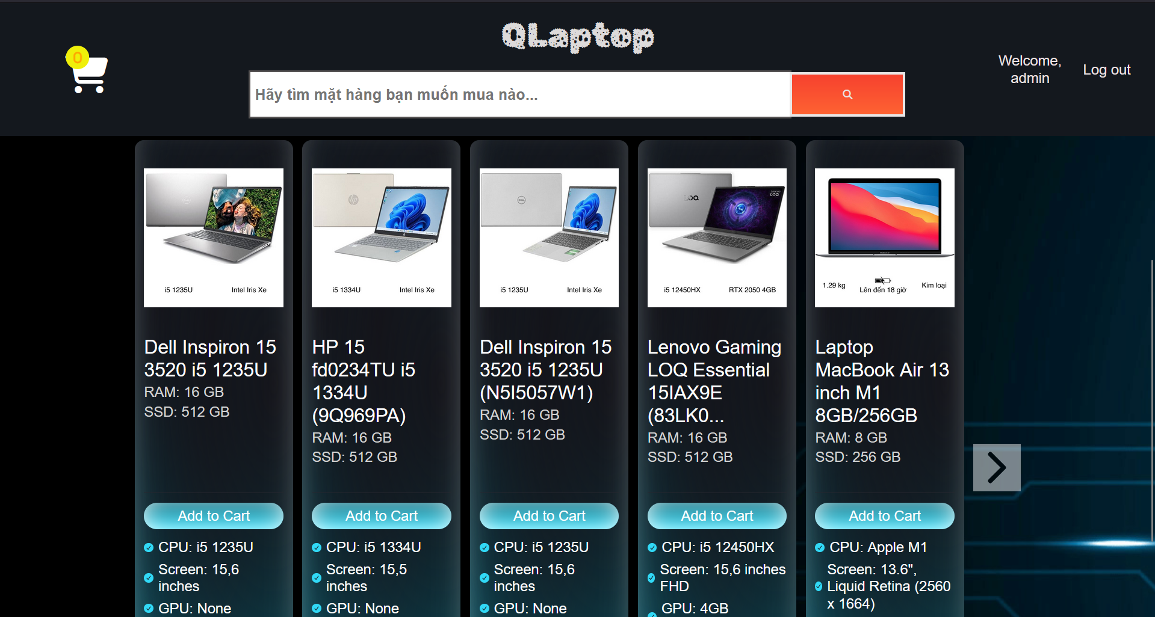
Main page

Slide 8
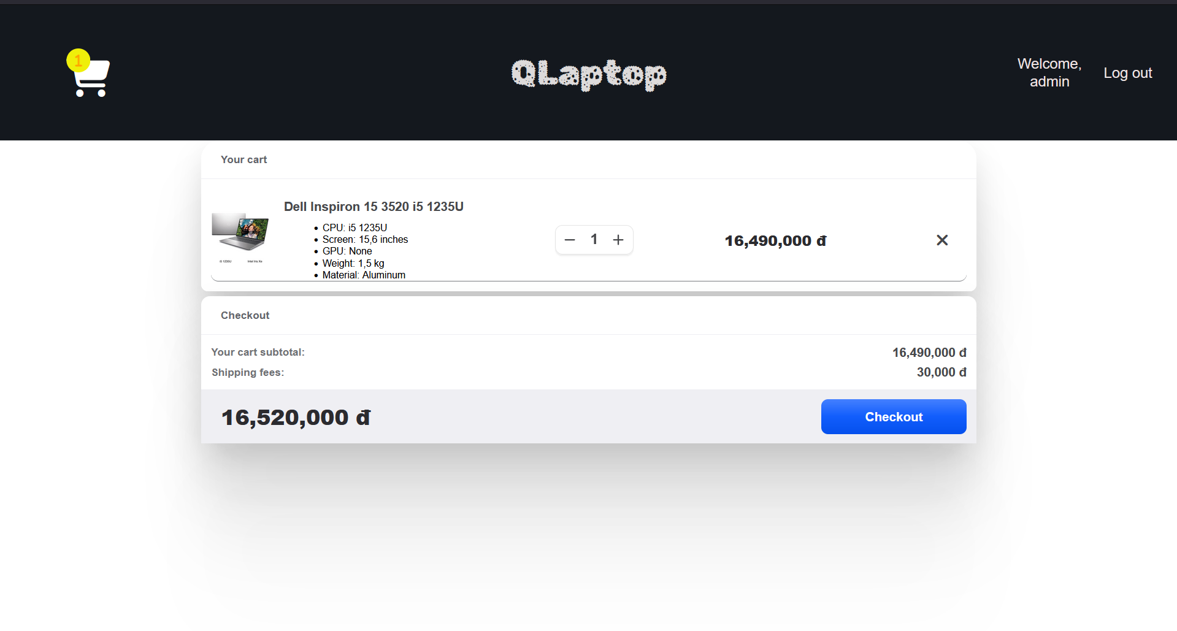
Cart Page

Slide 9
Thank you

